Slide 1




PROBLEM STATEMENT
Team Leader - Hrishikesh Yadav
Team Member -
Shravya Shetty
Avinash Kumar
#4 Analysis of FIR using AI/ML for Proper Act and Section
Table No - 103
Team Name - CrimeBusters
Registration ID - 433

Slide 2


PROBLEMS IDENTIFIED
Underutilization of the FIR Data.
Storing the PDF FIR data to the cloud is difficult in structured format.
IPC Section and other parameters prediction.
Multilingual Support.
More flexiblity to the analysis is required.

Slide 3

MOTIVATION TO BUILD
Passion to solve the real world problems.
A conversation with the STF Officer on solving the problem, and started working on the dynamic analytics.
Working towards the technological advancement and worked on 4 research work around AI.

Slide 4

SOLUTION DEVELOPED
CrimeDekho
To Reduce Crime Rates
Table No - 103
Team Name - CrimeBusters
Registration ID - 433

Slide 5

OBJECTIVES
OCR Extraction of FIR PDF into Structured Format.
Online FIR Registration with Voice Description of the FIR.
IPC Code and other critical points prediction
Support for the multilingual data
Mapping the Hotspot
Dynamic Analytics

Slide 6

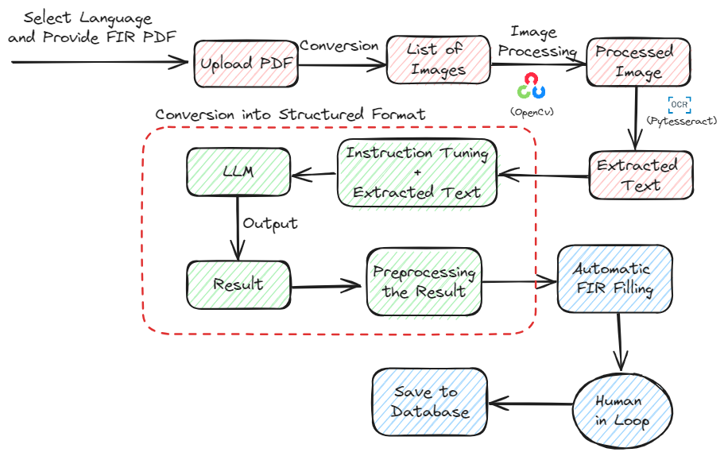
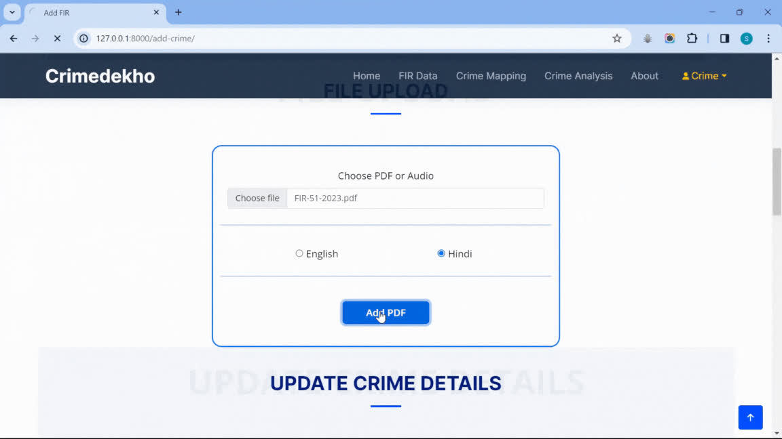
FEATURES -
OCR EXTRACTION TO STRUCTURED

Slide 7
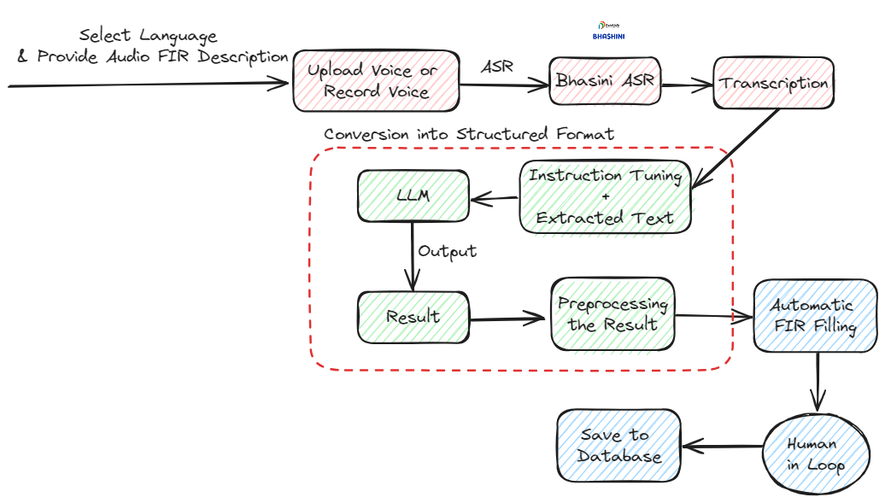

FEATURES -
VOICE BASED FIR

Slide 8
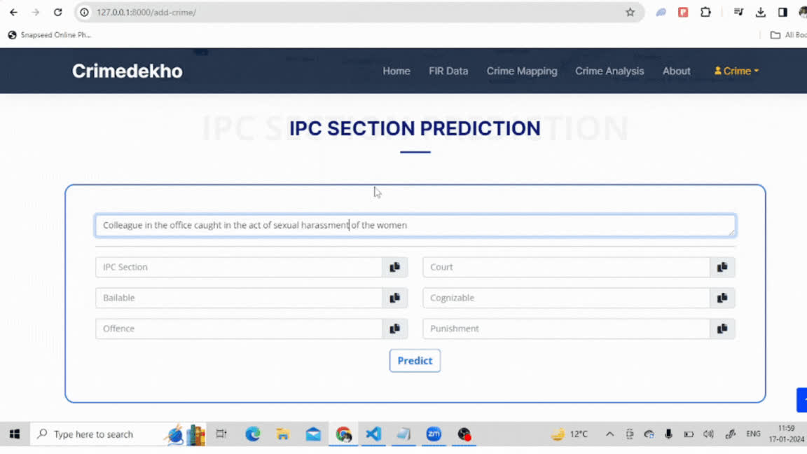
FEATURES -
IPC SECTION AND OTHER CRITICAL POINTS PREDICTION

Slide 9
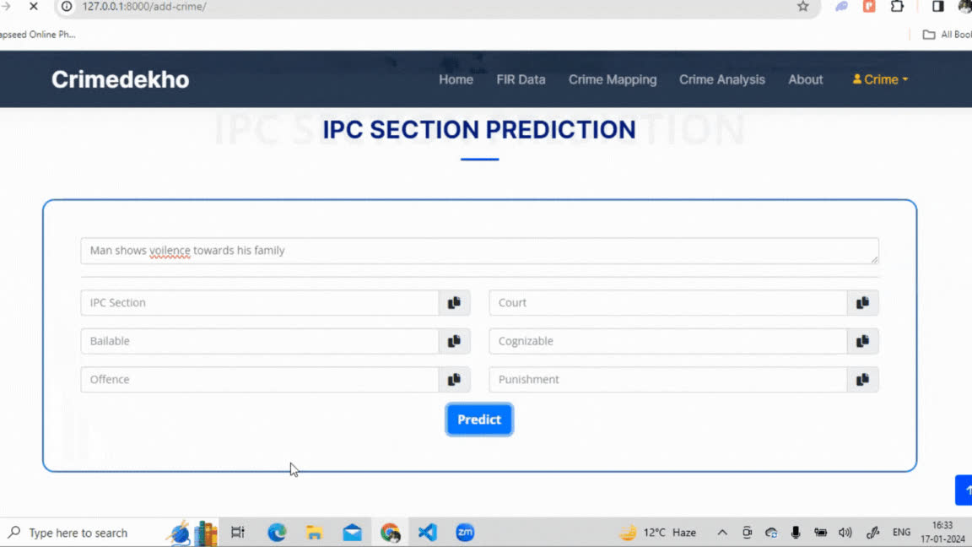
FEATURES -
IPC SECTION AND OTHER CRITICAL POINTS PREDICTION

Slide 10
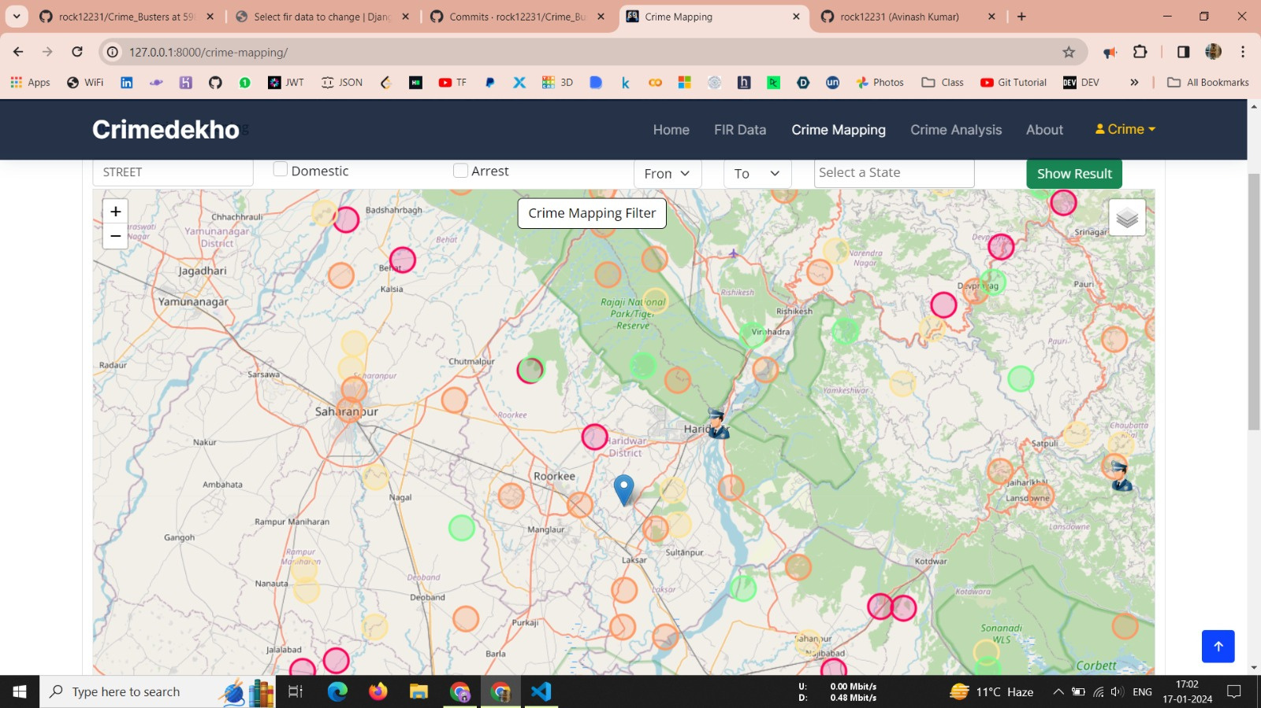
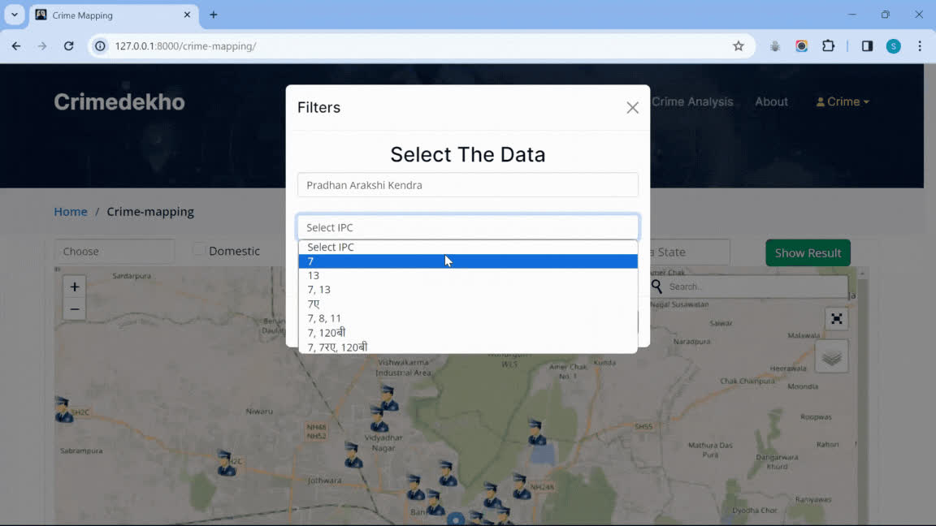
FEATURES -
CRIME HOTSPOT GENERATION

Slide 11
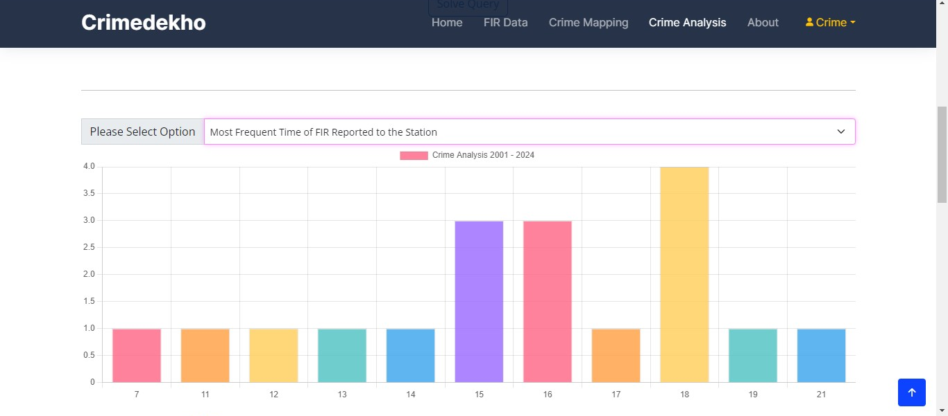
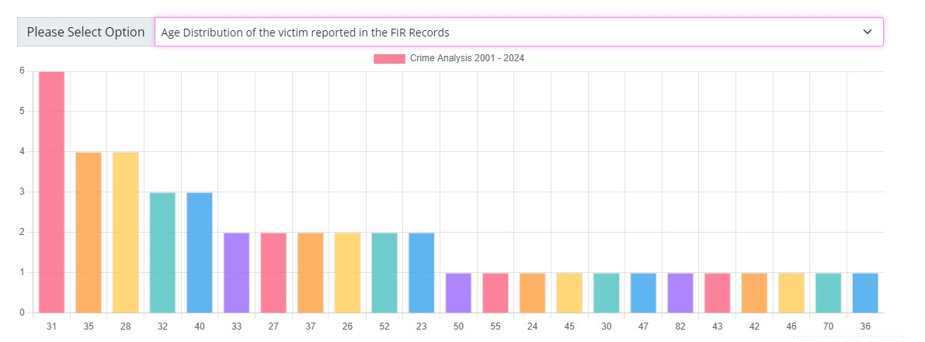
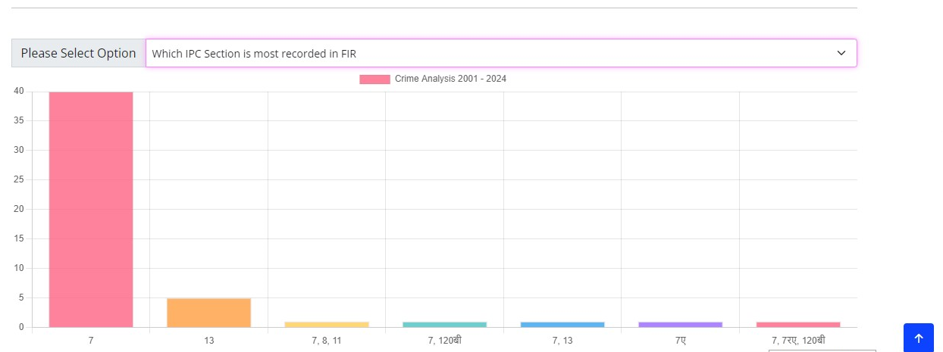
FEATURES -
DYNAMIC ANALYTICS

Slide 12
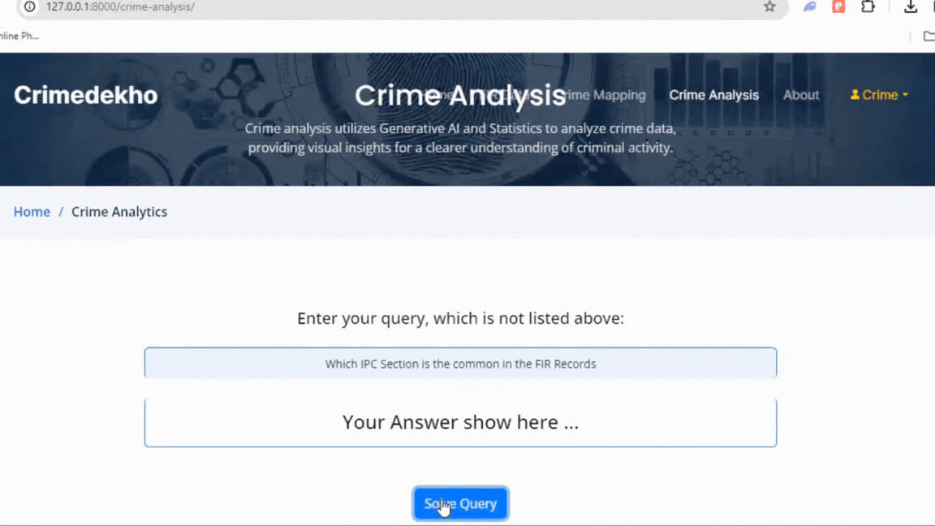
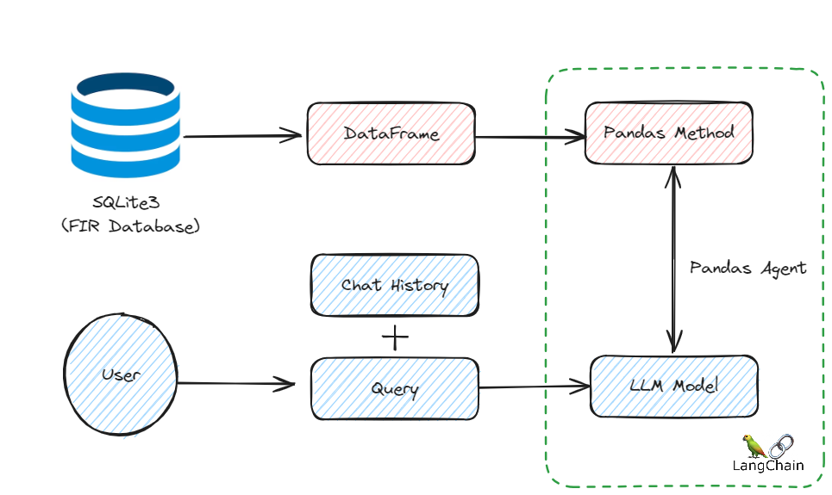
FEATURES -
DYNAMIC ANALYTICS
Working Architecture -

Slide 13
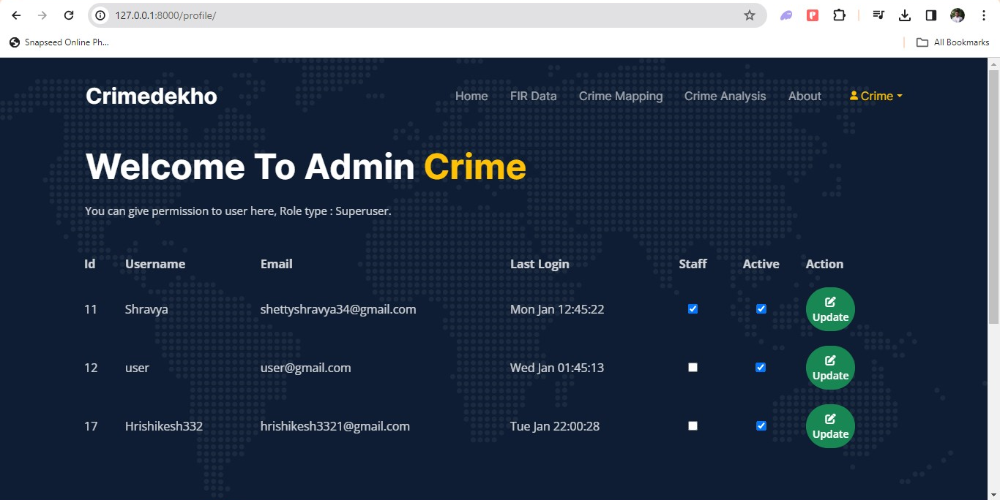
FEATURES -
ROLE BASED ACCESS CONTROL

Slide 14

IN TOUCH WITH BHASINI
Bhashini ASR Hindi model is integral to the Bhashini Project, contributing to AI-based language translation 8 Indian languages.
Significance as it aligns with the Digital India campaign.
Technology Advancement Support.

Slide 15

Maintenance & In-Department Use
FUTURE DIRECTIONS
Original Location Secific Dataset for the predictive policing.
Requirements -
More Data and CCTNS Data
Crime Patrolling as per the critical data location and then suggesting the shortest route.
Any women can report from anyplace with Police in Loop for Verification and noting with Aadhar verification.
FIR editor tool
Hindi Voice Transcription, Real Time with Bhasini

Slide 16
Thank You!!!

